Slide 1
3.3 : DIGITAL LINKS

Slide 2
The individual blocks of an optical fiber transmission link involves optical fiber transmission medium , optical source , photo detector and associated receiver and the connectors used to join individual fiber cables to each other and to the source and detector .
It should be examined how these individual parts can be put together to form a complete optical fiber transmission link.

Slide 3
Point to point links
The simplest transmission link is a point to point line that has a transmitter on one end and a receiver on the other.
Since the performance and cost constraints are very important factors in fiber optic communication links, the designer must carefully choose the components to ensure that desired performance level can be maintained over expected system life time .
Following key system requirements are needed in analyzing a link
The desired (possible) transmission distance
The data rate or channel bandwidth
Bit Error Rate

Slide 4

Simple point to point link

Slide 5
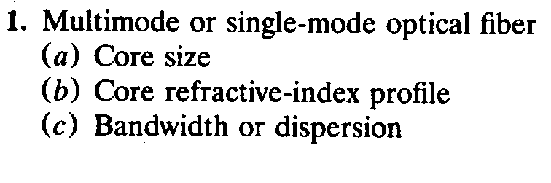
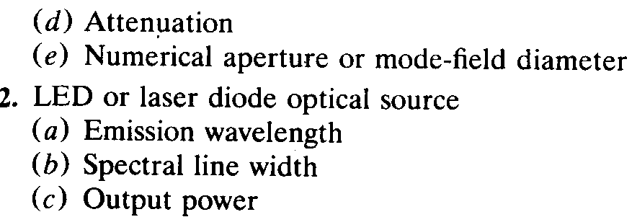
To fulfill these requirements the designer has a choice of the following components and their associated characteristics.

Slide 6
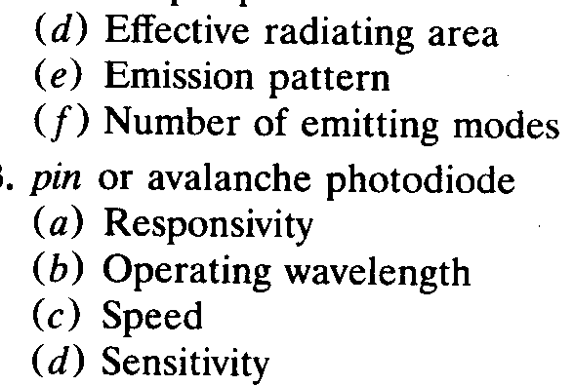

Slide 7
(1)Link power budget
(2) System rise-time budget
In Link power budget analysis one first determines the power margin between transmitter output and the minimum receiver sensitivity needed to establish a specified BER.
This margin can be allocated to connectors and splices , plus any additional margins required for other components , possible component degradations, transmission line impairments or temperature effects

Slide 8
If the choice of components did not allow the desired transmission distance to be achieved , the components might have to be changed or amplifiers might have to be incorporated into link.
Once link power budget has been established , the designer can perform a system rise time analysis to ensure that desired overall system performance has been met.

Slide 9
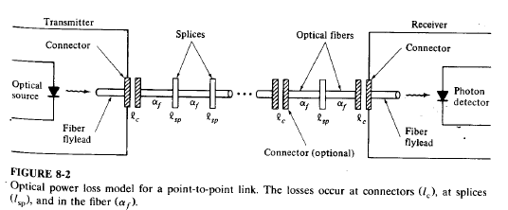
LINK POWER BUDGET

Slide 10
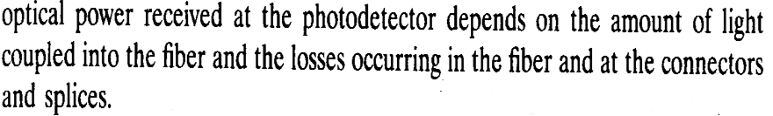

The link loss budget is derived from the sequential loss contributions of each element in the link .

Slide 11
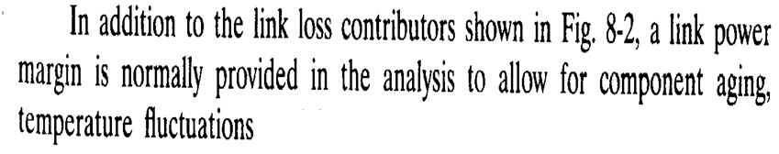
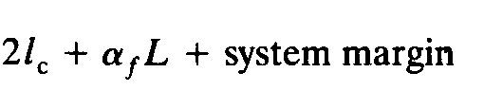
A Link margin of 6-8 dB is generally considered.
Total optical power loss allowed between source and detector,
PT =

Slide 12
In last equation assumptions are
Connectors are there only on the ends.
The splice loss is incorporated with fiber loss for simplicity.
System margin is 6 dB

Slide 13
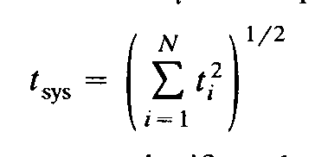
Rise Time Budget
Convenient method for determining dispersion limitation of an optical fiber link.
The total rise time of the link is the root sum square of the rise times from each contributor ti

Slide 14
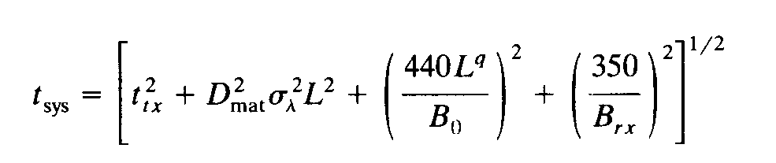
4 basic elements that may significantly limit system speed are transmitter rise time ttx, GVD rise time t gvd, modal dispersion rise time tmod and receiver rise time trx
For single mode fibers tmod will not be there.
In detail , total system rise time is given by

Slide 15
Bo is the bandwidth of 1 km length of the cable.
The parameter q ranges between .5 to 1
q= .5 --→ steady state modal equilibrium
q=1-→ mode mixing
B rx is 3 db bandwidth of receiver.

Slide 16
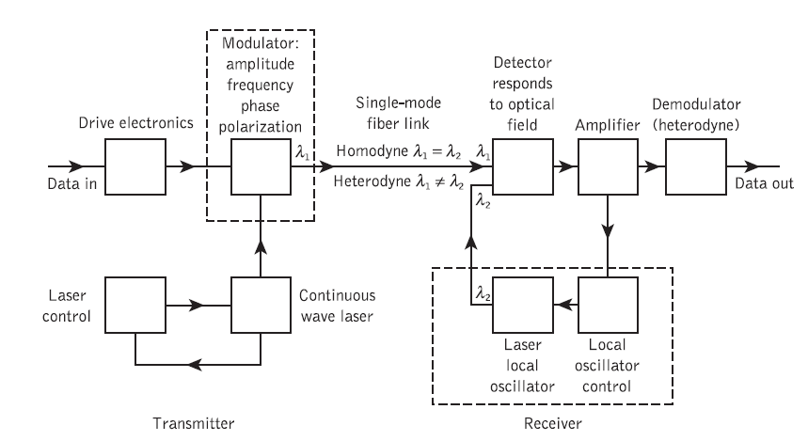
COHERENT DETECTION

Slide 17
Since the invention of the laser , research efforts have focused on techniques by which the coherent properties of laser light could be utilized for coherent optical communications.
At the transmitter a CW narrow-linewidth semiconductor laser is shown which acts as an optical frequency oscillator.
An external optical modulator usually provides amplitude, frequency or phase shift keying of the optical carrier by the information signal.
At present external modulators are generally waveguide
devices fabricated from lithium niobate or the group III–V compound semiconductors.

Slide 18
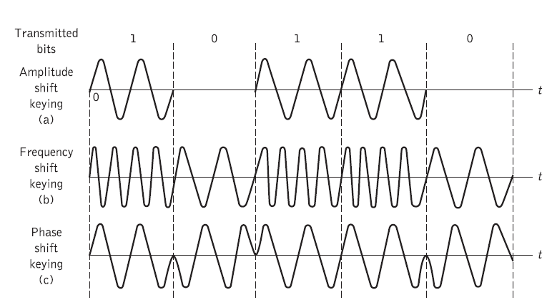

Slide 19
In the receiver side , the incoming signal is combined with the optical output from a semiconductor laser local oscillator.
This function can be provided by a single-mode fiber fused biconical coupler.
However, integrated optical waveguide couplers may also be utilized.
The combined signal is then fed to a photodetector for direct detection in the conventional square law device.

Slide 20
When the optical frequencies (or wavelengths) of the incoming signal and the local oscillator laser output are identical, then the receiver operates in a homodyne mode and the electrical signal is recovered directly in the baseband.
For heterodyne detection, the local oscillator frequency is offset from the incoming signal frequency and therefore the electrical spectrum from the output of the detector is centered on an intermediate frequency (IF) which is dependent on the offset.

Slide 21
This IF, which is a difference signal ( difference frequency), contains the information signal and can be demodulated using standard electrical techniques.

